Slide 1
Mobile shop management system

Slide 2
Survey
Paper Based Management
6/10 shops still use paper based management system.
Reasons
Expensive
Not user-friendly

Slide 3
Introduction
The Mobile Shop Management System is software which can become the backbone for a billing and inventory system for small organizations. This software provides an uncomplicated system to run mobile shops. This application could be very useful to small organizations. This application is inspired from current pen and paper based shop management systems. It will provide an easy and attractive interface so that the user can easily manage and utilize the application.

Slide 4
Objectives
To minimize the cost of manpower and paper work.
To give management accurate and updated reports about cash collection, products available etc.
Speed & Efficiency.
To give the details and solutions for the queries asked by the system timely and to give the precise and confirm information to them.
To keep records and other valuable information in safety so that unauthorized access of the information can be prevented. Unauthorized people cannot modify the records.
User-Friendly Interface
Affordable

Slide 5
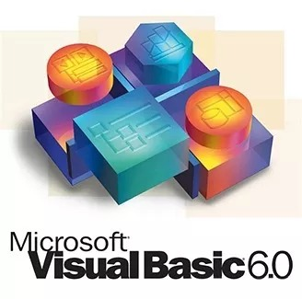

Frontend & Backend
Visual Basic 6.0
Oracle 11g

Slide 6
Why visual basic 6.0 as frontend?
ActiveX Data Objects (ADO) and OLE DB replace the Open database connectivity (ODBC) API as the preferred method for accessing shared file and client/server databases.
Visual Basic is an event driven programming language.
Visual Basic allows you to adopt more of parallel approach, with independent sections of code for each option that the user may select. This is known as Event driven programming language.
Drag and drop form generation.
ADO data control (ADODC).
Hierarchical record sets and the flex grid control.
Data report design.
Data form wizards.
Visual data tools.

Slide 7
Why oracle 11g as backend?
Most data management system based on the relational model has a built-in support for query languages like ANSI SQL or QBE (Query by Example). These queries are simple English constructs that allow adodc data manipulation from a table.
Deferred writing at commits to improve transaction performance.
Security and control.
It has a rollback command for recreating the database to its most recent safe point.
Professional ORACLE starts the DBMS (Database Management System) in the extended memory, so more main memory is available for other applications.
Relational model of data management is based on set theory. Built-in query language is designed in the RDBMS, so that it can manipulate sets of data (one or more tuples).

Slide 8
SYSTEM ANALYSIS

Slide 9
EXISTING SYSTEM
The existing system is not very effective & was highly time consuming.
The current system works manually.
The existing system was somewhat paper-based (paper-work) which takes time?
The rate at which the work done is very slow due to non-utilization of computerized system.
It does not provide better data facilities as well as data availability on fingertip.
Inconsistency was the major problem in the existing system as there is no proper facility was provided to update the data.
In case user wants to find out details of particular Mobiles whole database records are displayed.
It is difficult to remember all data
Consumes large volume of paper work
Large storage space is required to keep to the files and register in proper coordination’s.
In the present system the report generation becomes very difficult.

Slide 10
Proposed system
This system computerizes all data is storing all data of the Mobiles Sales, Customer Details etc.
Validation at the time of entering data, so no chance of duplication of data.
Extensive Validation on input record so that no changeable record are Prone to error.
Response time for the query should be minimized.
To keep data base up to date by regular updating.
Reduce the cost of maintaining system.
To provide various report facility.
Cost effective and less manpower required.

Slide 11
Advantages of proposed system
The new system would easily overcome most of the short coming of the current system.
Owner can see the fine report.
Not much manual work is involved.
Ensure data accuracy.
Security of data is done.
Save a lot of time and effort.
Optimize processing time.
User friendly system.

Slide 12
FEASIBILITY STUDY
Feasibility study is a report directed management. It evaluates the impact of the proposed changes in the area(s) in question. The report is a formal document for management, brief enough and sufficiently, non-technical to be understandable, yet detailed enough to provide the basis for system design.
An initial determine in a proposal that whether an alternative system is feasible or not. To determine feasibility of candidate system in all respect I need to consider following feasibility factors:
Technical feasibility.
Economic feasibility.
Operational feasibility.

Slide 13
Software requirements
FUNCTIONAL REQUIREMENTS: It defines functions of a system or its components. A function is described as a set of inputs, the behaviour, and the outputs. Behavioural requirements describing all the cases where the system uses the functionality requirements are captured in use cases.
Some of the functional requirements of our project are as follows
The user shall be able to search either all the initial set of database.
The system shall provide appropriate viewers for the user to read documents in document Shop.
Every reservation shall be allocated a unique identification.

Slide 14
NON- FUNCTIONAL REQUIREMENTS: The requirements that specifies criteria that can be used to judge the operation of a system, rather than specific behaviour. This should be contracted with functional requirements that define specific behaviour or functions.
Response time should be less then specified time, input screen be self-explanatory, user friendly, attractive, accurate.
Some non-functional requirements are:
Fast (Response time be less than specified time)
Accurate (Up three places after decimal)
User friendly (Input screen be Self-Explanatory )
Attractive ( Aesthetically appealing)

Slide 15
SYSTEM REQUIREMENTS
The most common set of requirement defined by any operating system or software application is the physical computer resources, also known as hardware, a hardware requirements list is often accompanied by a hardware compatibility list (HCL), especially in case of operating system.
The Hardware and Software Configuration for the proposed system is given below.
Hardware Configuration
Hardware | Minimum Requirement
Processor | Pentium 2
Hard disk | 4 GB
RAM | 500 MB
Software Configuration
Front End | Visual basic 6.0
Back End | Oracle 11g
Platform | Windows XP,7 & 10

Slide 16
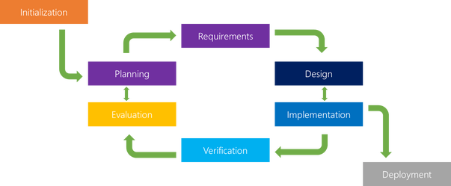
SYSTEM DESIGN
System design is the process of defining the architecture, components, modules, interfaces, and data for a system to satisfy specified requirements. System design could be seen as the application of the systems theory to product development.
In our project we are implementing Iterative model for developing our project.

Slide 17
Why iterative model?
The advantages of the Iterative and Incremental SDLC Model are as follows −
Some working functionality can be developed quickly and early in the life cycle.
Results are obtained early and periodically.
Parallel development can be planned.
Progress can be measured.
Less costly to change the scope/requirements.
Testing and debugging during smaller iteration is easy.
Risks are identified and resolved during iteration; and each iteration is an easily managed milestone.
With every increment, operational product is delivered.
During the life cycle, software is produced early which facilitates customer evaluation and feedback.

Slide 18
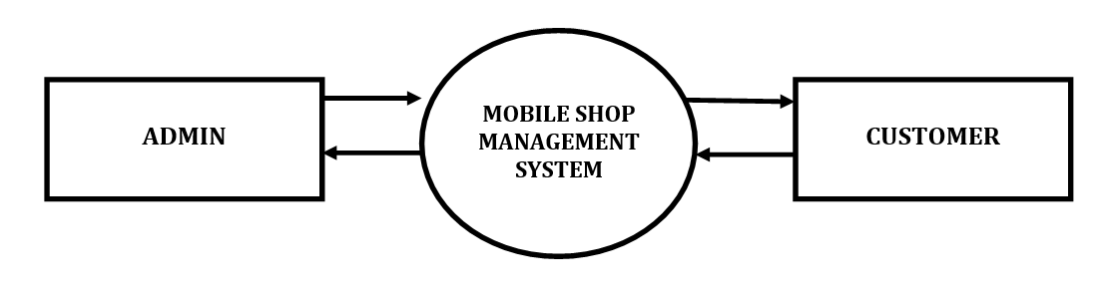
DATA FLOW DIAGRAM
A Data Flow Diagram (DFD) is a graphical technique that depicts information flow and the transformations that are applied as data move from input to output. The data flow diagram is known as a data flow graph or a bubble chart.
CONTEXT LEVEL DIAGRAM

Slide 19
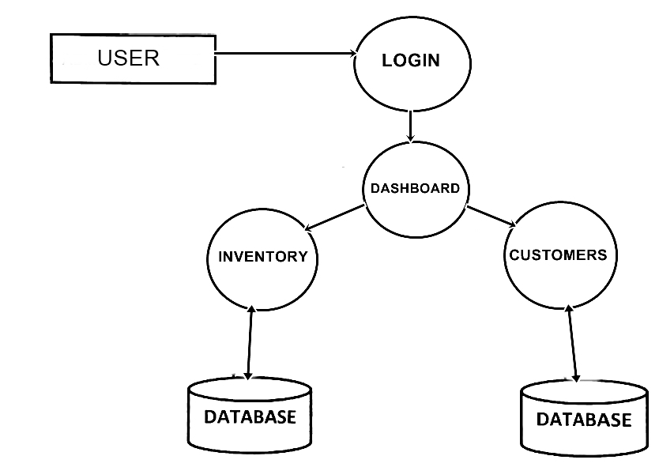
LEVEL 1 DIAGRAM FOR PROCESS

Slide 20
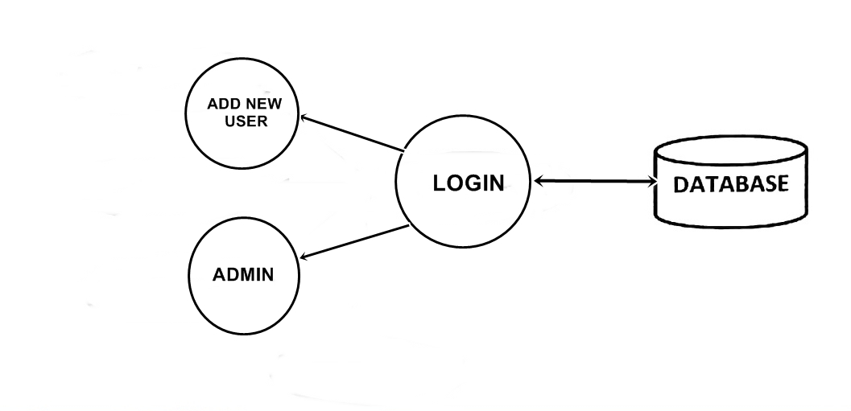
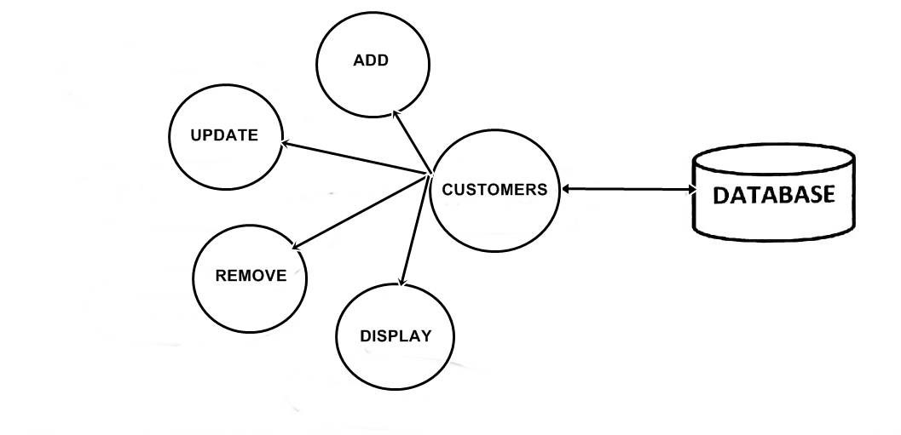
LEVEL 2 DIAGRAM FOR PROCESS

Slide 21
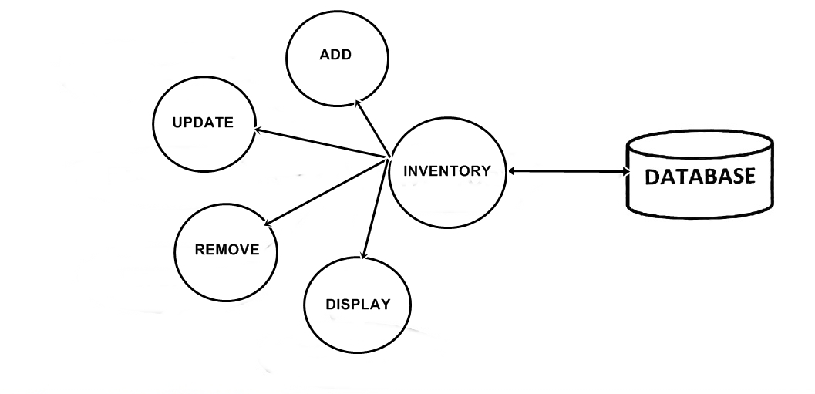
LEVEL 3 DIAGRAM FOR PROCESS

Slide 22
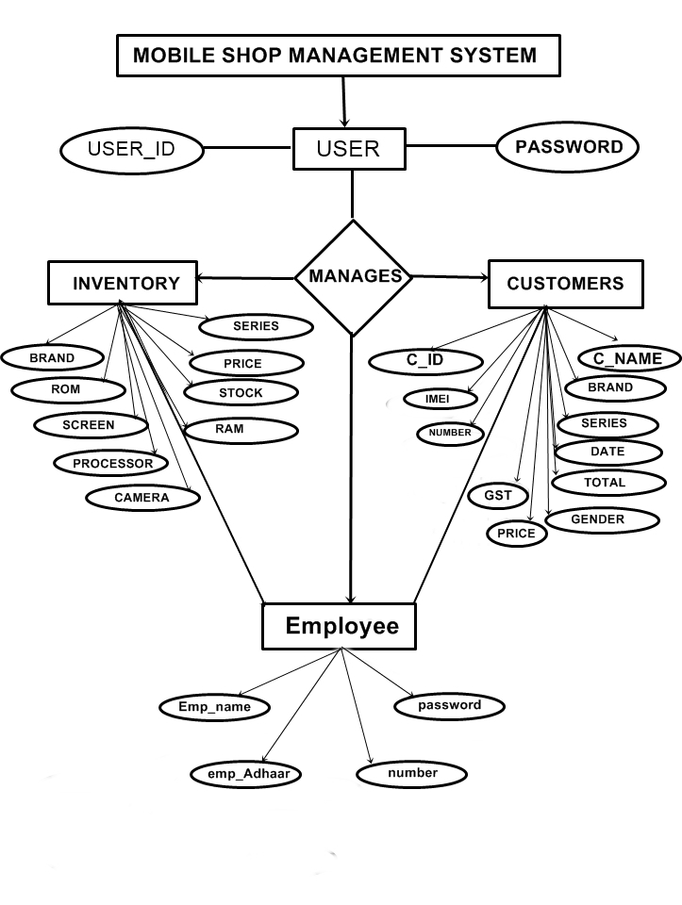
ER MODEL

Slide 23
NORMALIZATION
Database normalization is the process of removing redundant data from the tables to improve storage efficiency, data integrity and scalability. The classification is called normal forms (or NF’s) and they show how algorithms are converting a given database between them. Normalization generally involves splitting existing tables into multiple ones, which must be re-joined or linked each time a query is issued.
1 NF (FIRST NORMAL FORM)
A table is in 1 NF if:
There are no duplicate rows in a relation.
Each data value stored is single valued
Entities in the column are of same type
ORDER ID | PRODUCT NAME
01 | APPLE , SAMSUNG
02 | SAMSUNG , NOKIA
03 | NOKIA , SAMSUNG
04 | ONE PLUS , APPLE

Slide 24
Rule 1:
A column with atomic data cannot have several values of same type in it. In the above table there are multiple values for item name value, this can be overcome by creating multiple columns for multiple values.
ORDER ID | PRODUCT NAME 1 | PRODUCT NAME 2
01 | APPLE | SAMSUNG
02 | SAMSUNG | NOKIA
03 | NOKIA | SAMSUNG
04 | ONE PLUS | APPLE
It satisfies rule 1 but the table is not in 1 NF
Rule 2:
A table with atomic data cannot have multiple columns with same type of data.
ORDER ID | PRODUCT NAME
01 | APPLE
01 | SAMSUNG
02 | SAMSUNG
02 | NOKIA
03 | NOKIA
03 | SAMSUNG
04 | ONE PLUS

Slide 25
Second Normal Form (2NF):
A table is in 2NF if & only if it is in 1NF and every non-key attribute is fully functionally dependent on the whole of the primary key.
Tables are said to be in 2NF when
The tables meet the criteria for 1NF.
If the primary key is a composite of attributes (contains multiple columns), the non key attributes (columns) must depend on the whole key.
Any table with a primary key that is composed of a single attribute (column) is automatically in 2NF.
Our project supports both 1NF and 2NF.
The primary key in our project is “ CUSTOMER ID “
ORDER ID | CUSTOMER ID | CUSTOMER NAME | PRODUCT ID | PRODUCT NAME | PRICE
01 | 7001 | MUDASSIR | APL1004 | APPLE | 50000.00
02 | 7002 | SHADUL | SAM234 | SAMSUNG | 45000.00
03 | 7003 | FAISAL | NKI925 | NOKIA | 35000.00
04 | 7004 | FAHAD | ONNO4 | ONE PLUS | 25000.00

Slide 26
PRODUCT ID | PRODUCT NAME | PRICE
APL1004 | APPLE | 50000.00
SAM234 | SAMSUNG | 45000.00
NKI925 | NOKIA | 35000.00
ONNO4 | ONE PLUS | 25000.00
ORDER ID | CUSTOMER ID | CUSTOMER NAME
01 | 7001 | MUDASSIR
02 | 7002 | SHADUL
03 | 7003 | FAISAL
04 | 7004 | FAHAD
CUSTOMER ID | CUSTOMER NAME
7001 | MUDASSIR
7002 | SHADUL
7003 | FAISAL
7004 | FAHAD

